Slide 1


Can Data predict the Mega Millions or is it a Mega Trap?
A statistical exploration of the winners and the winning numbers from 2002 – 2021
Alberta "Albi" Kovatcheva & Barbra Treston

Slide 2

EDUCATION:
ENTITY Academy: 2020 - PRESENT
New York University: MS Mechanical Engineering 2019
Employment:
NJ Dept. Of Environmental Protection:
Case Manager | 2020 - PRESENT
Con Edison:
Supervisor | 2019 - 2020
Area of Expertise:
Energy Industry
Why Data Science?
To learn about the world using data analytics
Alberta
"Albi"
Kovatcheva

Slide 3

EDUCATION:
ENTITY Academy: 2020 - PRESENT
City College Of NY: MA Mental Health Counseling
Employment:
A-1 Universal Care, Inc:
Director of Self-directed Services | 2019 - PRESENT
Support Broker | 2018 - PRESENT
Medicaid Service Coordinator/Care Manager | 2017 - 2018
Area of Expertise:
Psychology, Behavioral Health, Social Service
Why Data Science?
To improve mental health care by deepening research
and directing resources where they will be most effective
Barbra
Treston

Slide 4
It all Started with a Plan Get Rich Quick ….
Who hasn’t dreamed of hitting the jackpot and changing their life forever?
Many people try every day. However, almost no one expects to win

Slide 5
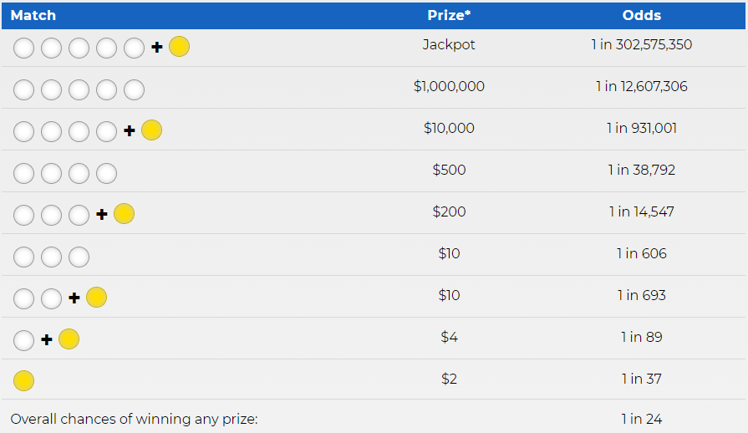
What are the odds?
The numbers are chosen by
random number generator
To win the jackpot, players
must choose a 6 numbers
correctly:
  5 numbers between
  1 and 70 (the white balls)
  1 number between
  1 and 25 (the gold Mega Ball)
There is a 1 in 24 chance of winning something,
BUT the odds of winning the jackpot is 1 in 302,575,350

Slide 6
How does it work?
Massive consistent income from ticket sales (more than $9 billion a year in New York state)
Organizers set the prize amounts, not near reflective of the probability of winning the prize.
Profits subsidize basic public programs
Can also exacerbate socioeconomic inequality
  ≈ 70% of lottery winners end up going broke
  Winners of $50k or more have increased risk of filing bankruptcy within 5 years
Scams happen
  Hot Lotto Scandal
  Nefarious entities

Slide 7
The Data
Lottery Mega Millions Winning Numbers: Beginning 2002 (data.ny.gov)
Jackpot History and Winners Gallery (megamillions.com)
The Questions
Can machine learning predict lottery outcomes to players receive a minimum ROI?
Is there a difference between the earnings of men and women?
Is it best not to play at all?
’

Slide 8
Data Collection and Wrangling Strategies
Wrangled and recoded the data to extract month, day, year, weekday, & quarter from 'Draw Date’
Scraped megamillions.com for data on Jackpot winners and Non-jackpot winners
Merge Winning Numbers Data with Winner Data by 'Draw Date’
Languages &Tools
Python 3.10.0 & R 4.1.2
Jupyter Notebook, Visual Studio Code, Tableau, & Github.
’

Slide 10
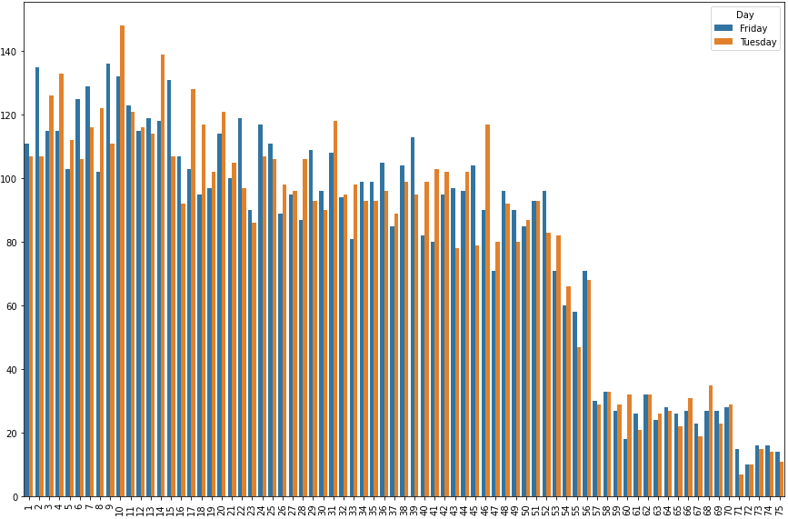
Winning Number Frequencies by Day of the Week (2002 - 2020)
Frequency of Occurrence
Winning Numbers

Slide 11
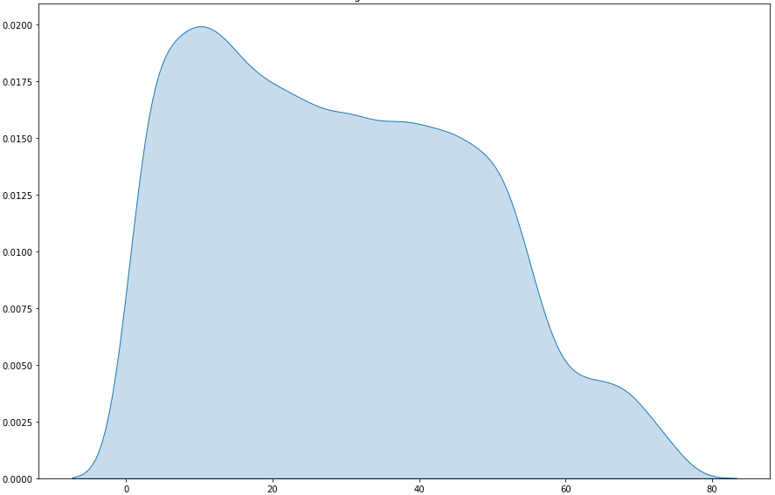
Winning Numbers Kernel Density Estimation (KDE) Plot
KDE plot shape is highly similar for month, day, year, etc.
Probability Density Function (PDF) Estimate
Winning Numbers

Slide 12
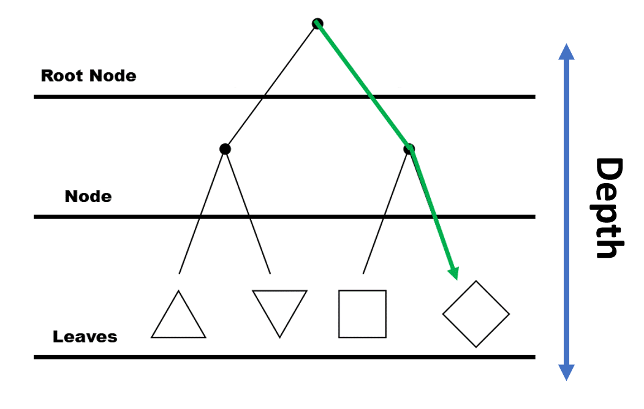
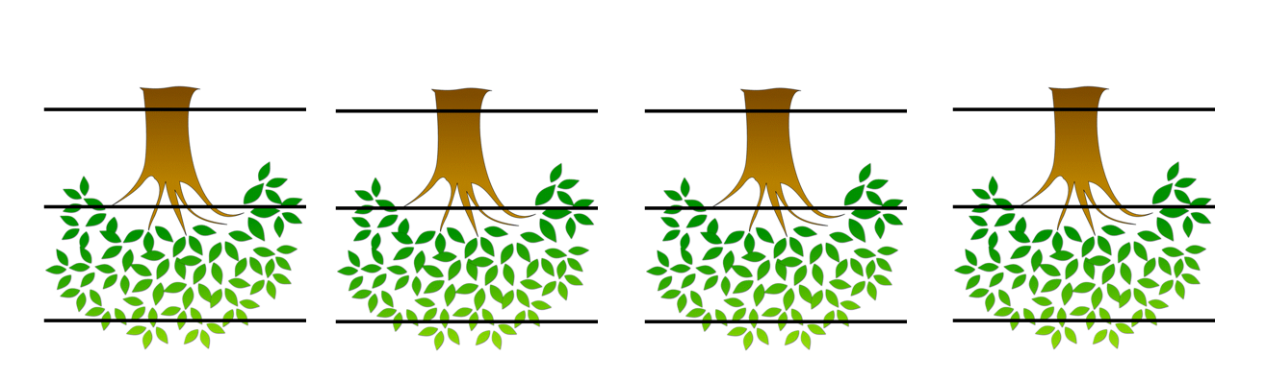
Can machine learning predict lottery outcomes to players receive a minimum ROI?
What is machine learning?
Decision trees vs. random forests.
Classifier vs. regressor.
Maximum Depth
Number of Estimators

Slide 13
Predictors and response variables:
Predictors:
Month
Day
Year
Day of the Week
Quarter
Response:
Winning Numbers.
Parameters used for Random forest
classifier model:
500 estimators
2 Minimum number of samples for a leaf
‘auto’ Maximum number of features
20 Maximum depth
Maximum Depth
Number of Estimators

Slide 14
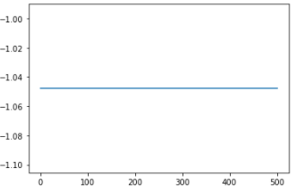
Can machine learning predict lottery outcomes to players receive a minimum ROI?
What is machine learning?
What is a random forest classifier model?
Random forest classifier model accuracy is approx. 1%.
Flat curve.
80% or greater is considered ‘good’ accuracy.
Machine learning ends at accuracy levels
50% or below.
What this means about the data.
Applications of Machine Learning.
Random Forest Model Effectiveness
Results
Number of Estimators

Slide 15
Feature Importance
Day of the month seems to have the most influence on winning lottery numbers.
Accuracy is still approximately 1%.
Assessment of Feature Importance
Quarter
Day of the Week
Month
Year
Day
Feature Importance

Slide 24
Questions ?

